Slide 1
Research Overview
Fall 2023 - Spring 2024
Nikki Chun

Slide 2
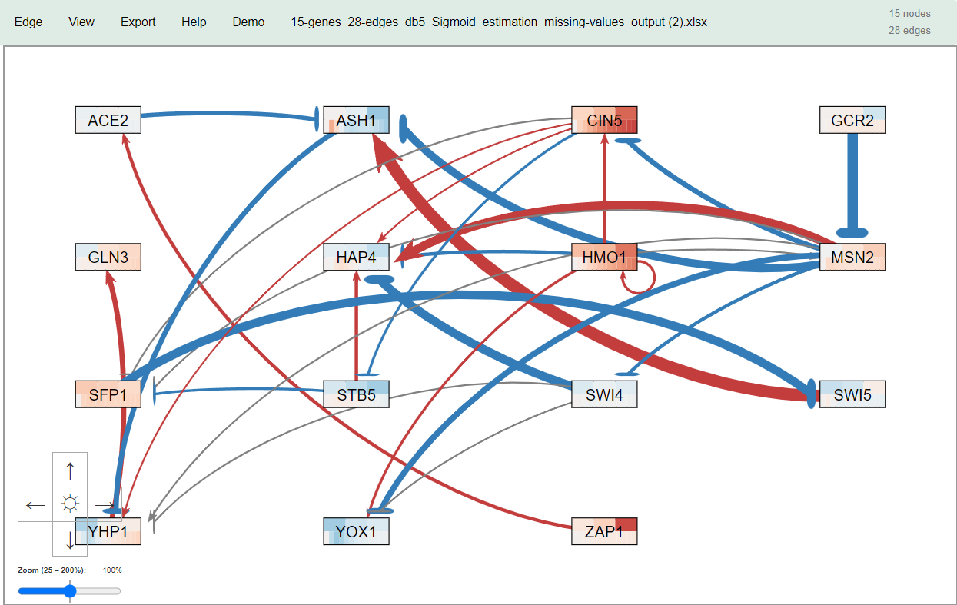
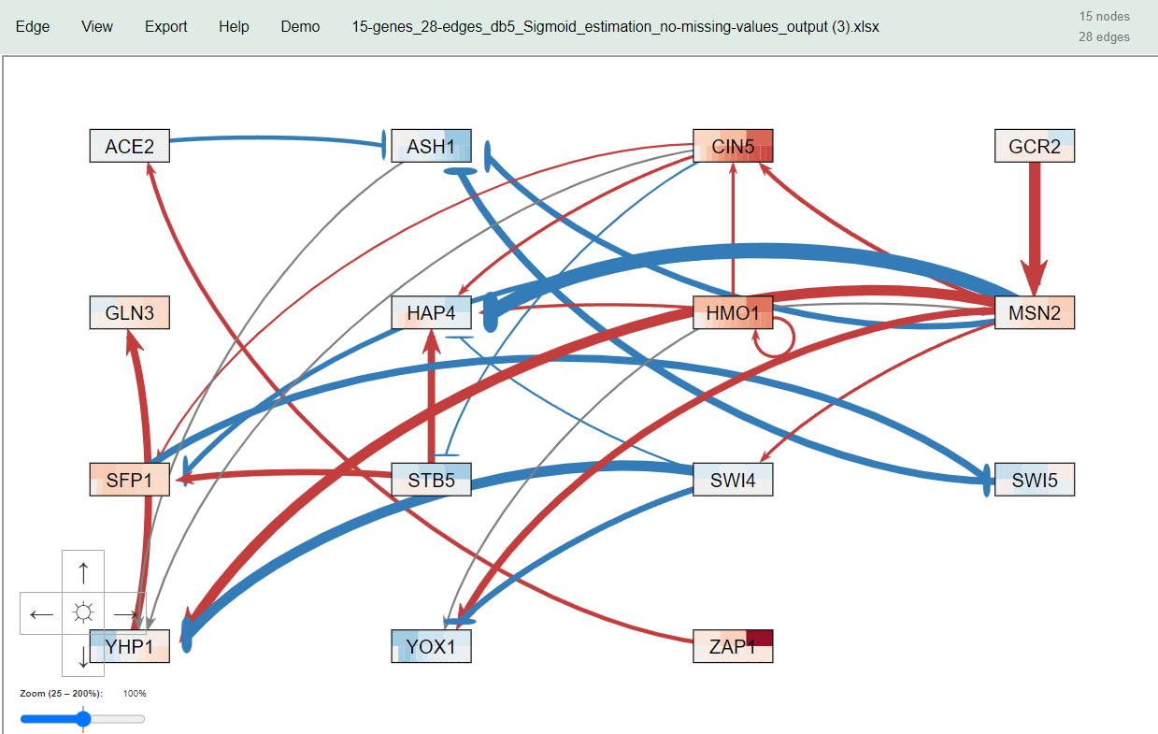
Missing vs. no missing data output variance
When comparing missing and no missing data sheets from db5 there was a difference in the optimization output of expression data, p’s, b’s, and network weights
Weight variance can be seen clearly in the GRNsight output of the data sheets where magnitude and even sign where altered for 9 of the 24 of the nodes

Slide 3
Incorrect input worksheet for no missing data
It was expected that outputs for missing vs. no missing data networks would be similar or even identical so the difference in outputs led us to investigate reasons why this difference may have occured
Analysis of the input workbooks for the no missing data sheets revealed that some of the calculated values that were replacing the missing data points were incorrect
  The missing data points were supposed to be filled with the average expression data value from each timepoint, but several of those values on the db5 workbook were incorrect
  Filling the missing datapoints with the average doesn’t change the average value for each timepoint, so the fact that the values were wrong caused the averages to be different which would likely alter the results
After this finding, the other workbooks were checked and some of the filled missing values for the other gene networks (db1-db7) were also found to be incorrect
These values were then manually corrected and run through GRNmap again

Slide 4
Missing vs. corrected no missing data output variance
There was slight improvement in the different between missing and no missing data outputs when the replaced missing values were corrected

Slide 5
Missing vs. corrected no missing data output variance
There was a larger % difference between the optimized B’s than the optimized production rates

Slide 6
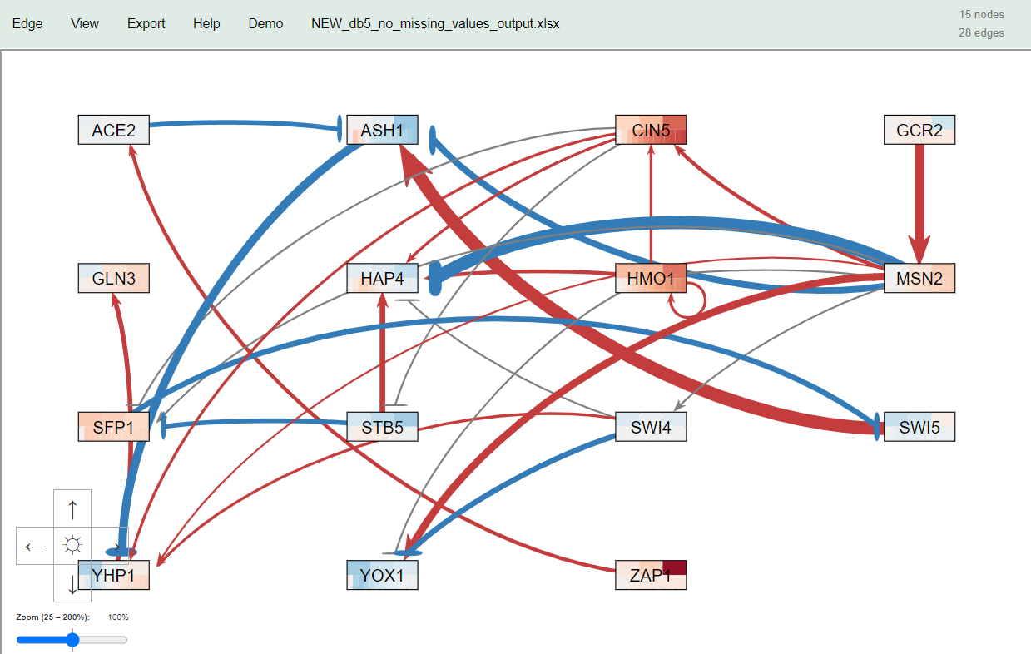
Missing vs. corrected no missing data output variance
Missing values
Original no missing values
Corrected no missing values
Compared to the missing value GRN, there were 9 nodes that switched signs for the original no missing value GRN. The corrected no missing value GRN compared to the missing value GRN had 7 nodes that switched signs.

Slide 7
Alpha value of 0.002 vs. 0.02
Since the differences between the missing and no missing value networks were still so different, we continued to investigate why
It was discovered that the input workbooks for all the GRNs had an alpha value of 0.002 rather than the expected 0.02
Workbooks 1, 2, and 5 were rerun with the corrected alpha value
Ultimately, it was found that an alpha value of 0.02 is more suitable with an alpha value of 0.002 causing overfitting

Slide 8
Db5 production rate comparisons
An alpha value of 0.02 caused the difference in P values to be smaller between the missing and no missing values
The maximum difference between missing and no missing with and alpha value of 0.002 was about 222% larger than the maximum difference when the alpha was 0.02
The mean difference is about 67% larger for an alpha value of 0.002 than an alpha value of 0.02

Slide 9
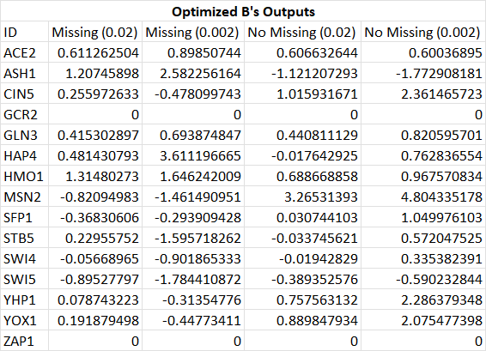
Db5 B value comparisons
Additionally alpha value of 0.02 caused the difference in B values to be smaller between the missing and no missing values
The maximum difference between missing and no missing with and alpha value of 0.002 was about 65% larger than the maximum difference when the alpha was 0.02
The mean difference is about 260% larger for an alpha value of 0.002 than an alpha value of 0.02

Slide 10
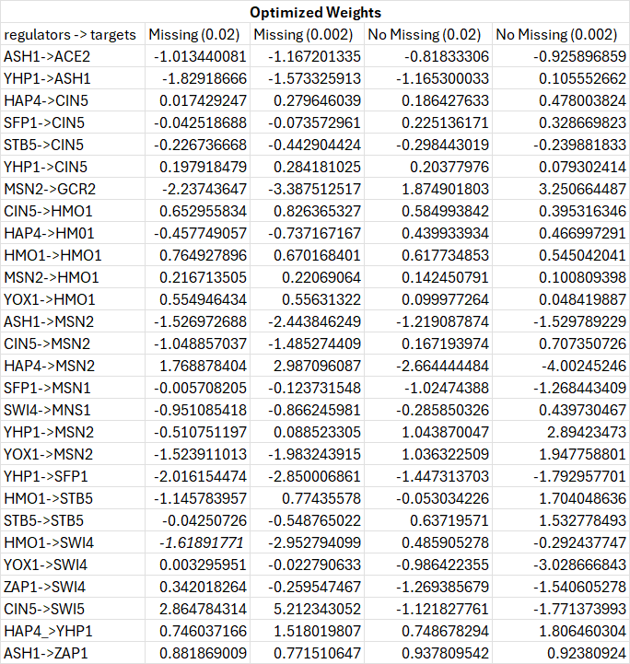
Db5 weights comparisons
The maximum difference in magnitude between missing and no missing with and alpha value of 0.002 was about 150% larger than the maximum difference when the alpha was 0.02
The mean difference is about 60% larger for an alpha value of 0.002 than an alpha value of 0.02
There were, however, 2 more weights with sign changed when the alpha value was 0.02

Slide 11
Creation of “toy” network overview
Necessary because of variances between GRNmap outputs of data from missing and no missing data network even with an altered alpha value
Purpose: Generate a network with 3 nodes and 4 edges for further analysis
Methods:
Used one of the R scripts on the GitHub to attempt to generate all possible connected networks of 3 nodes and 4 edges
Averages of db5 data were taken to use as P’s and B’s
Forward simulations were then conducted to generate the expression data

Slide 12
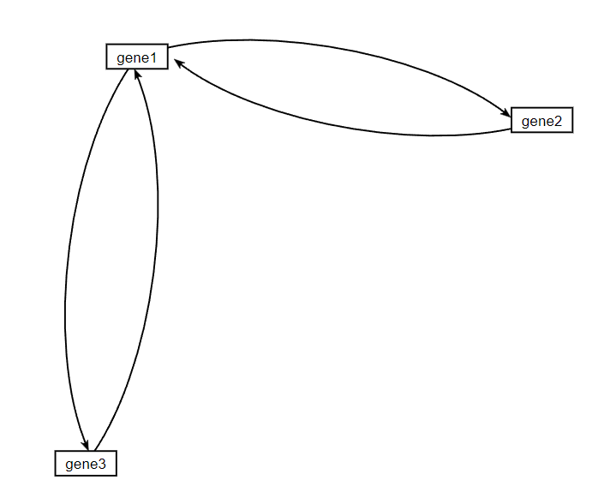
Network data derived from forward simulation
-1
Production rate | 0.30644
Degradation rate | 0.15323
B | 0
2
-1
-2
Expression Data
ID | 15 | 30 | 60
gene1 | 0.426021278 | 0.423962034 | 0.419529208
gene2 | -1.03989826 | -1.248269014 | -1.265979944
gene3 | -2.145961699 | -2.865096631 | -2.954936982

Slide 13
Alpha value manipulation overview
A series of manipulation to the data was then conducted beginning with using a smaller alpha.
    Since there is inherently no noise in our model, a smaller alpha was needed
  Alpha values of 10^-8 and then combinations of this smaller alpha value and also holding the P’s and B’s constant were used as inputs
  There continued to be variance between the expression data and the expected expression data from the forward simulation

Slide 14
Output data comparisons
Alpha value | P’s | B’s | Weights
0.02 | gene1: 0.390145 gene2: 0.131109 gene3: 0.041794 | gene1: -0.06465 gene2: -0.00779 gene3: 0.001361
2x10⁸ (holding P’s and B’s constant) | gene1: 0.30644 gene2: 0.30644 gene3: 0.30644 | gene1: 0 gene2: 0 gene3: 0
2x10⁸ | gene1: 0.949439087 gene2: 4.371493476 gene3: 6.127960108 | gene1: 1.882189526 gene2: 3.206721452 gene3: 3.366824606

Slide 15
Alpha value and tolx/tolfun manipulation overview
The alpha value was then once again lowered to 10^-15 now. Runs were conducted with this lowered alpha value combined with smaller tolx and tolfun values.
For each combination of changed inputs (tolx, tolfun, and tolx and tolfun) runs were conducted with holding P’s, holding B’s, holding P’s and B’s and no constants.

Slide 16
A minimized tolfun vs tolx did not produce a significant difference in output

Slide 17
Minimizing both tolfun and tolx
When both the P’s and B’s are held constant, a smaller tolfun and tolx has the same result as when just one of each variable is minimized
When all parameters are being optimized, however, minimizing both tolx and tolfun produces similar P’s and B’s to the outputs when just tolfun and tolx are minimized, but the weights are significantly different and are further from the expected weights

Slide 18
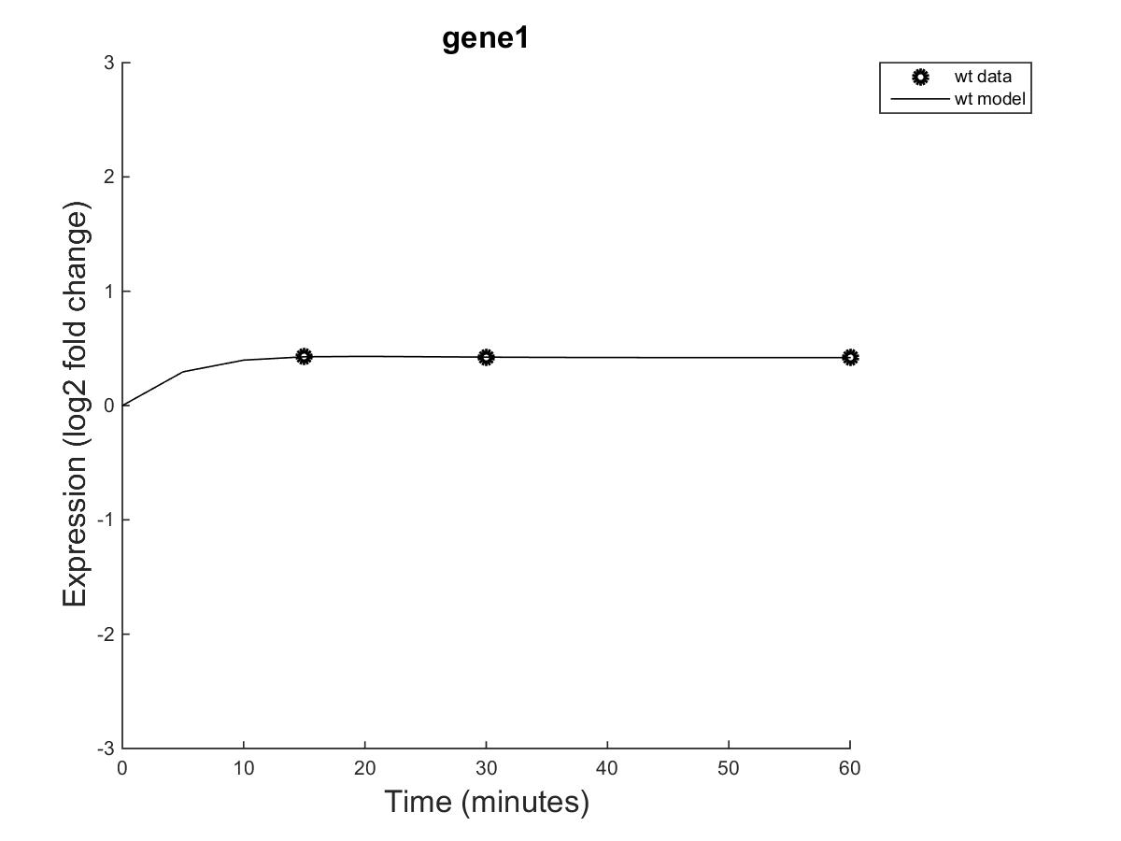
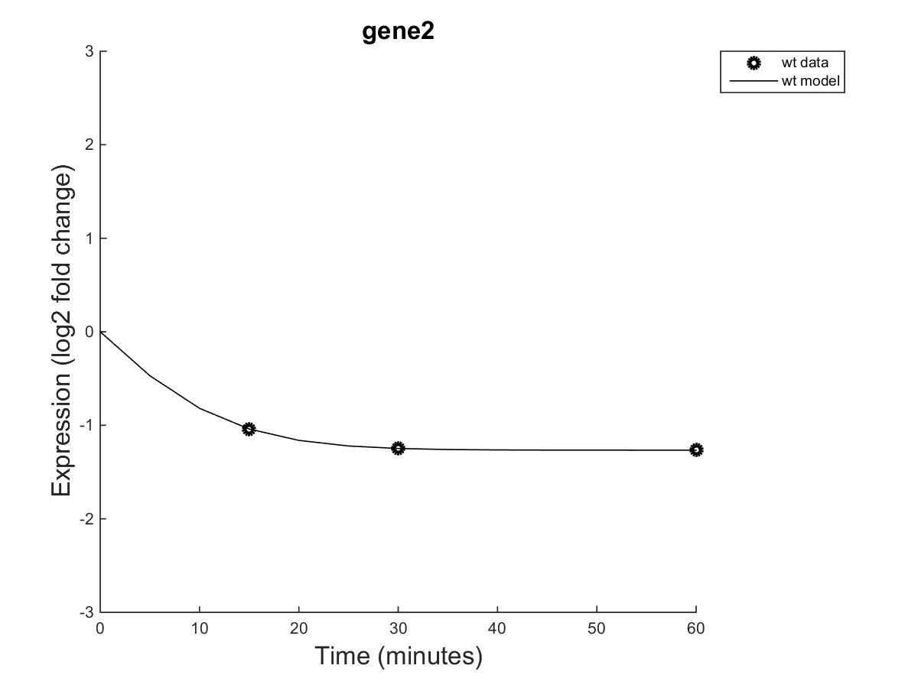
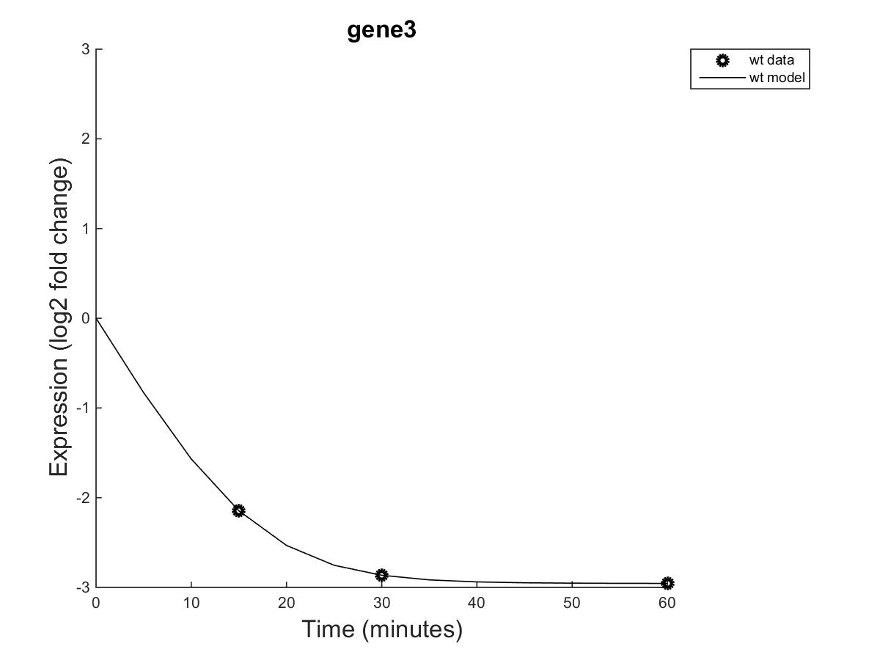
Changing timepoints of expression data
After viewing each gene’s output graph, it was observed that the data levels out and becomes steady relatively fast (within the first 10-15 minutes). As such, the variance that was found might not be a problem of the model, but rather the data being too steady.
To further evaluate this claim, runs were attempted with input workbooks created from the data within the first 15 minutes (timepoints at 5, 10, and 15 min)

Slide 19
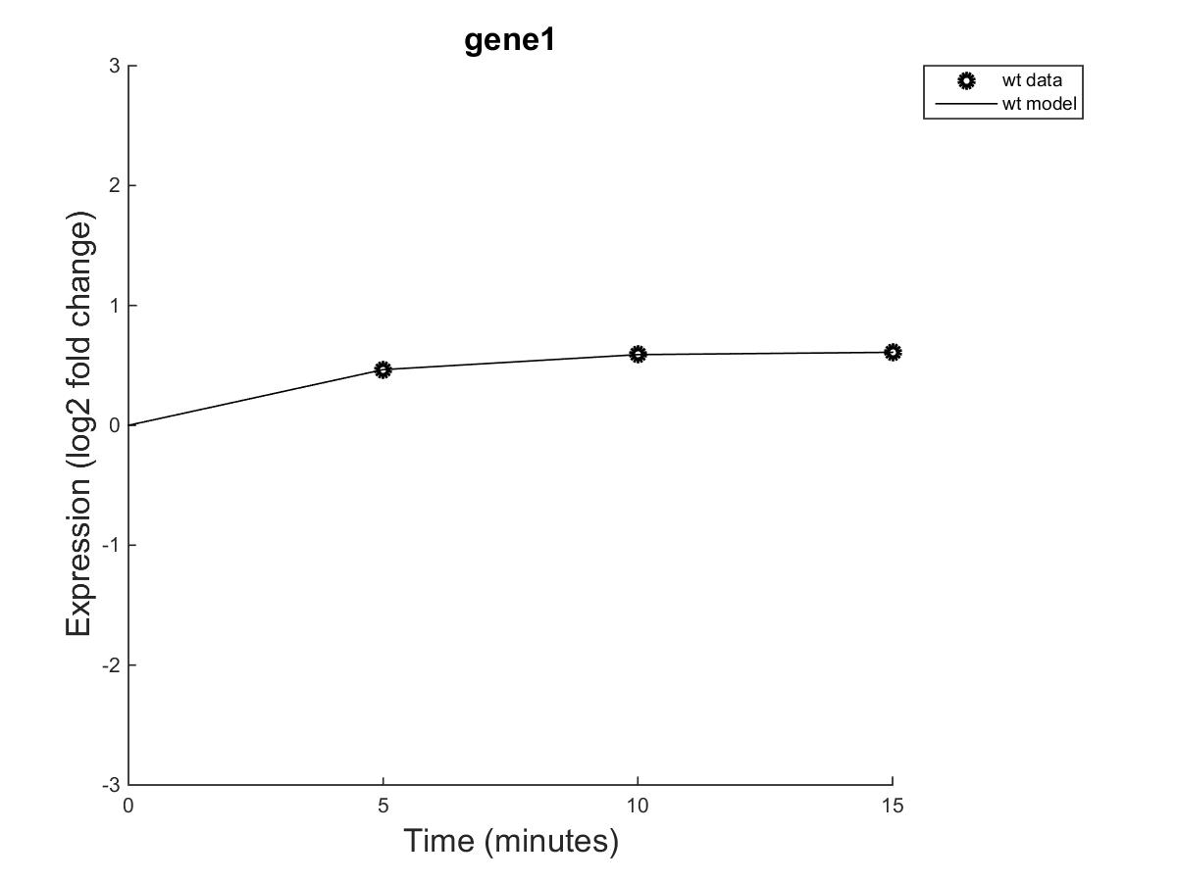
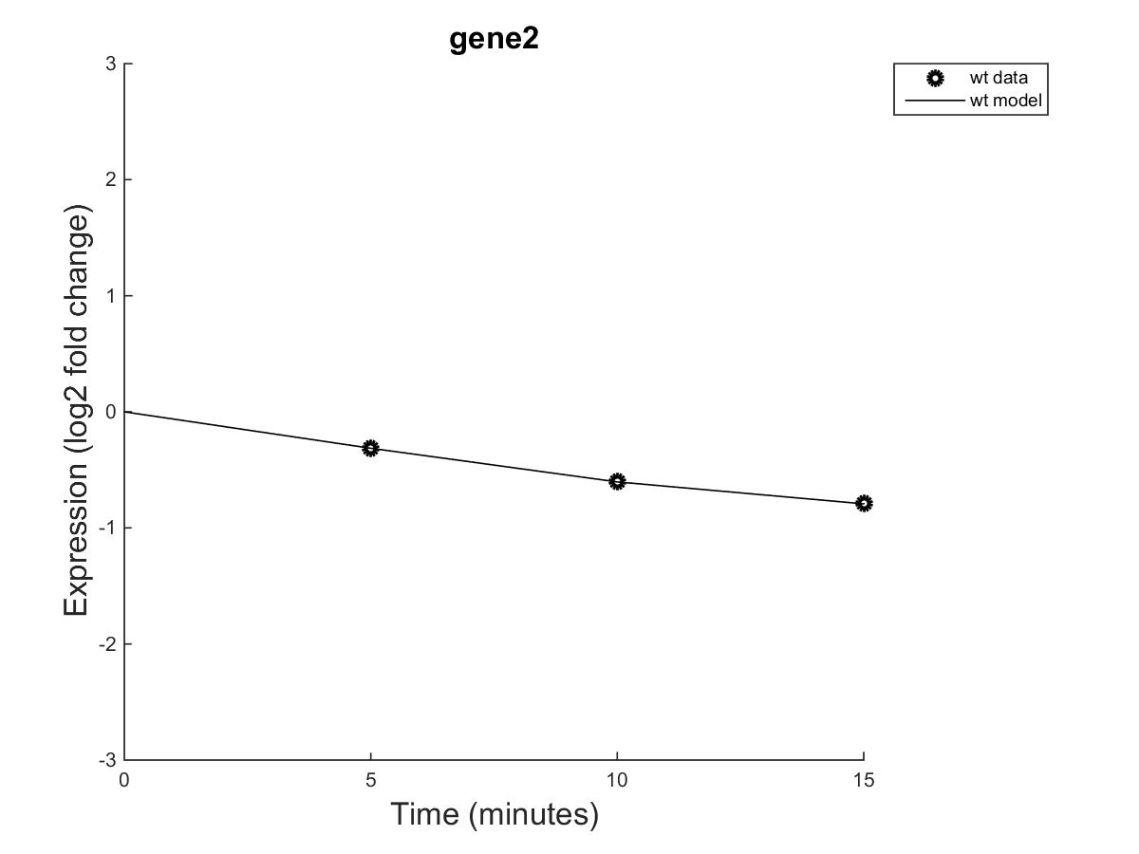
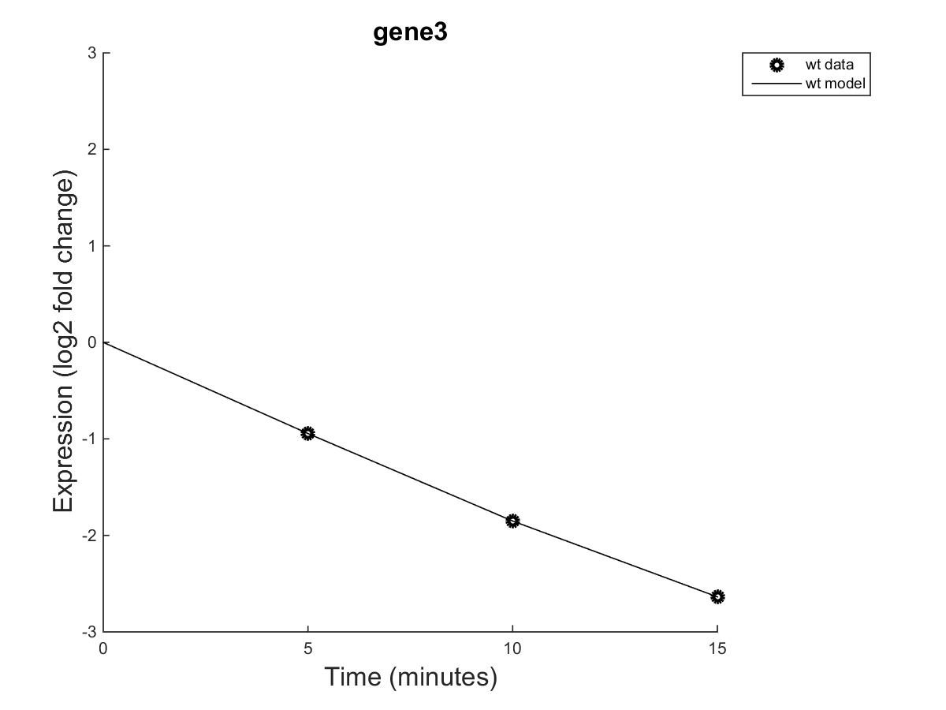
Timepoints at 5, 10, and 15 minutes
Altered timepoints showed a slower leveling off the expression data and produced somewhat different outputs
Values close to the sample parameters were still not recovered
*note: for these results all the parameters were being estimated*

